Slide 1

Heart Disease Percentile Prediction
Team Number: 18PCS_36
Nitte Meenakshi Institute of Technology
(AN AUTONOMOUS INSTITUTION AFFILIATED TO VISVESVARAYA TECHNOLOGICAL UNIVERSITY, BELGAUM)
PB No. 6429, Yelahanka, Bangalore 560-064, Karnataka
Telephone: 080- 22167800, 22167860, Fax: 080 - 22167805
Department of Computer Science and Engineering
Submitted by:
Anubhav Yadav (1NT18CS017)
Kinshuk Chaturvedi (1NT18CS076)
Neha V M (1NT18CS106)
Muskan Khatwani (1NT18IS202)

Slide 2
Table Of contents
Introduction
Background
Problem Statement
Research Objectives
Literature Survey
System Requirements
Architecture Design
Flow of Project
Conclusion
References

Slide 3
Introduction
Modern life's hectic pace results in an unhealthy lifestyle that breeds anxiety and sadness. To deal with an inclination of immerse usage in excessive drinking, smoking and drug usage. All of these factors are the underlying causes of a number of deadly diseases, such as cancer and cardiovascular conditions.
Artificial intelligence refers to a machine's capacity to execute tasks that are traditionally handled by humans. Machine learning is a type of artificial intelligence that allows software applications to become more accurate at predicting outcomes without being explicitly programmed to do so.

Slide 4
Background
Cardiovascular diseases are a broad term that refers to a variety of conditions that can affect your heart. According to the World Health Organization, cardiovascular diseases cause 17.9 million deaths worldwide and hence it is the leading cause of death.
Numerous studies have been conducted in an effort to properly identify all risks associated with heart disease and to establish particular risk factors. It is also known as a "silent killer", as it frequently results in death without showing any major symptoms of the condition until it's too late. It is crucial to anticipate these diseases early so that preventative actions can be undertaken before something terrible occurs.

Slide 5
Problem Statement
Given a set of data pertaining to patients' clinical parameters, the problem is to clean the dataset and choose an appropriate algorithm which gives high accuracy in predicting the likelihood of diagnosing the patient with cardiovascular disease.

Slide 6
Research Objectives
The primary objects of the work is:
to design and build a user-friendly interface that anyone can use to test the heart health status.
to preprocess the dataset in order to increase the efficiency of models by allowing for the accurate service possible when making decisions.
to select a suitable machine learning algorithm for the project with high accuracy of results.
to find the dominant factors resulting in cardiovascular diseases.

Slide 7
Literature survey
Title: Heart disease prediction using machine learning algorithms (2020)
Author: Harshit Jindal, Sarthak Agrawal, Rishabh Khera, Rachna Jain and Preeti Nagrath
Contribution:
Using a dataset of patients' medical histories, including information on chest pain, glucose levels, increased blood pressure, and other symptoms, this method estimates the likelihood that a patient will have cardiovascular disease.
KNN, Random Forest Classifier, and Logistic Regression were used in the creation of the presented model. By cleaning the dataset and utilizing KNN and logistic regression to obtain an average accuracy of 87.5%
It is determined that KNN accuracy of 88.52 % is the greatest of the three algorithms they utilised.

Slide 8
Title: Prediction of Cardiovascular Disease Using Machine Learning Algorithms (2018)
Author: Dinesh Kumar G, Arumugaraj K, Santhosh Kumar D, Mareeswari V
Contribution:
Pre-data analysis is used in the proposed study to remove uncleaned data, delete data that isn't there, fill in default values when they're available, classify predictive qualities, and make decisions at various levels.
Methods including categorization, precision, sensitivity, and relevance studies were used to assess the diagnostic model's efficacy. The prediction model can be used to detect cardiac issues and notify or diagnose the patient.
Support vector machine, Random forest Classifier and Logistic regression were the classifiers employed.
The accuracy for these models were, SVM 79.77%, Random Forest 80.89%, and Logistic Regression 86.51%.

Slide 9
Title: Effective Heart Disease Prediction Using Hybrid Machine Learning Techniques (2019)
Author: Senthil Kumar Mohan, Chandrasegar Thirumalai, And Gautam Srivastava
Contribution:
Machine learning algorithms were used in this work to analyse the raw data.
The suggested Hybrid Random Forest Linear Model approach was created by combining the characteristics of Random Forest and Linear Method. It proved to be highly accurate in predicting heart disease.
This research can be conducted in the future using a variety of machine learning methodology combinations to improve prediction methods.
New feature selection methods can also be developed in order to gain a better grasp of the crucial elements and boost the precision of heart disease prediction.

Slide 10
Title: Efficient Prediction of Cardiovascular Disease Using Machine Learning Algorithms with Relief and LASSO Feature Selection Techniques (2021)
Author: Pranab Ghosh, Sami Azam, Mir jam Jonkman, Asif Karim, F. M. Javad Mehedi Samrat, Eva Ignatius
Contribution:
This study used machine learning to attempt to predict cardiac illness, using a larger dataset to train the model.
It demonstrated how the Relief feature selection approach may be used with a variety of machine learning methods to create a strongly linked feature collection.
It found that Relief feature selection produces accuracy that is significantly greater than comparable work and performs particularly well with high impact features. With 10 characteristics, Relief feature selection was 99.05 % accurate.
The model will eventually be further generalised in order to be strong against datasets with large levels of missing data and to interact with additional feature selection approaches.

Slide 11
System Requirements
Hardware Requirements:
RAM: 4GB or more.
Processor: Intel Core i3 or i5 editions.
CPU: 1.6GHz n above.
Storage: 5GB
Software Requirements:
Programming Language: Python
Machine Learning: Scikit-learn, Streamlit
Data Preprocessing: NumPy, Pandas
Data Visualization: Seaborn, Matplotlib

Slide 12
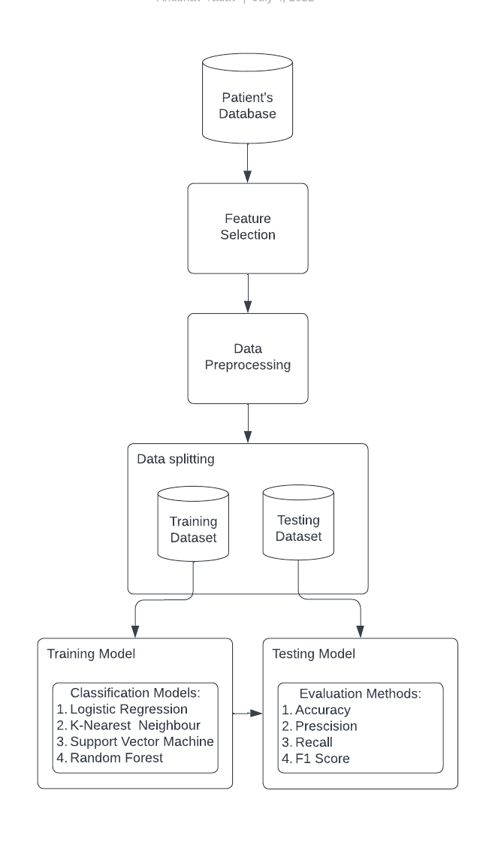
The Architectural Design
The main stages of the design are:
Patient’s Database
Feature Selection
Data Preprocessing
Data Splitting
Training & Testing the Models

Slide 13
Patient’s Database
This dataset contains 4 databases concerning heart disease diagnosis. All attributes are numeric-valued. The data was collected from the four following locations:
Cleveland Clinic Foundation
Hungarian Institute of Cardiology, Budapest
V.A. Medical Center, Long Beach, California
University Hospital, Zurich, Switzerland
Each database has the same instance format. While the databases have 76 raw attributes.

Slide 14
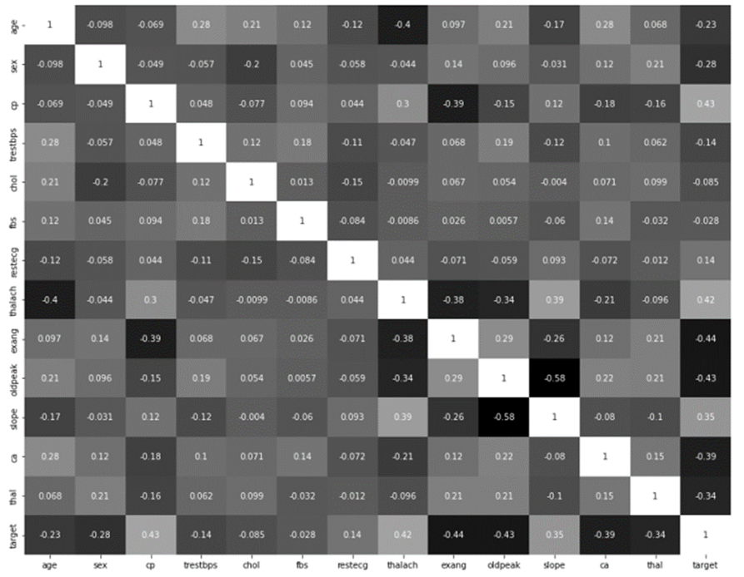
Feature Selection
Although there are 76 attributes in this database, all published trials only use a subset of 14 of them that are linked to heart disease. Age, sex, cp, trestbps, chol, fbs, restecg, thalach, Exang, oldpeak, slope, ca, and thal are the attributes included in the chosen new dataset. The final predicted attribute will be specified in ‘num’.
Heatmap

Slide 15
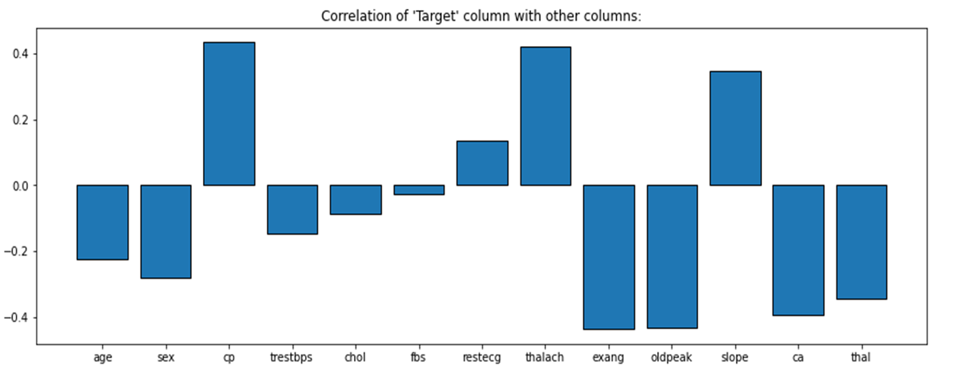
Similarly, it can be seen from the above correlation that there is no single feature that has a very high correlation with the target.

Slide 16
14 important attributes which are used in the research are:
SN | ATTRIBUTE | DESCRIPTION
1 | Age | Age of patient
2 | Sex | Patient’s gender (M-0, F-1)
3 | Cp | Type of chest discomfort
4 | Trestbps | Blood pressure at rest (hospital admission values in mmHg, ranging from 94 to 200)
5 | Chol | Mg/dl of serum cholesterol (ranges from 126 to 564)
6 | Fbs | Glucose level at fasting > 120 mg/dl (false-0,true-1)
7 | Resting | Electrocardiogram recorded when at rest (0 to 1)
SN | ATTRIBUTE | DESCRIPTION
8 | Thalach | Reached maximum heart rate (71 to 202)
9 | Exang | Angina caused by exercise (yes-1, no-0)
10 | Oldpeak | ST Depression during exercise in relation to the quantity of rest received (0 to .2)
11 | Slope | The slope of the ST workout segment's peak (0 to 1)
12 | Ca | Fluoroscopically coloured major vessels (0 to 3)
13 | Thal | Defect type (0 to 2)
14 | Target | Heart Disease Result

Slide 17
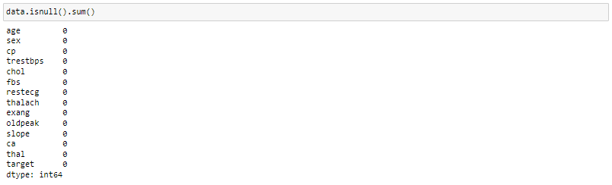
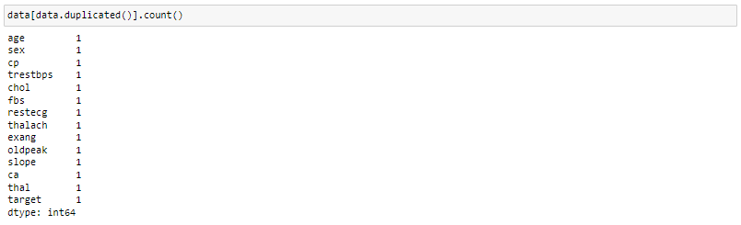
Data preprocessing
Handling Null Values
Checking for duplicate values

Slide 18
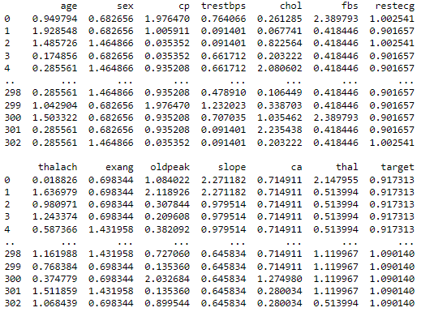
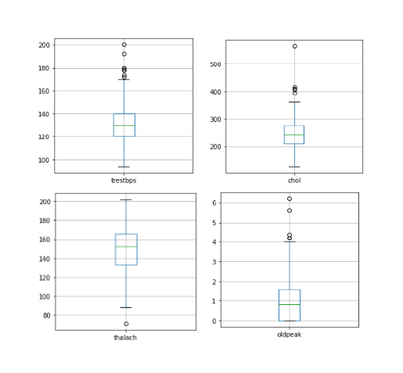
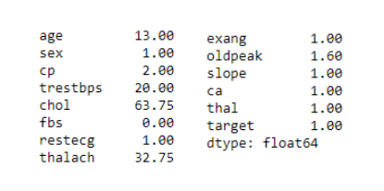
Check for Outliers
An observation that appears to differ significantly from other observations in the sample is known as an outlier. An outlier might represent flawed data or it can also point to important scientific phenomena.
Using Boxplot
2. Using IQR Score
3. Using Z Score

Slide 19
Handling Categorical Values
All input and output variables must be numbers for ML models. This means that in order to fit and assess a model, categorical data must first be converted to integers. Here, hot encoding is applied to that one. Each category value is transformed into a new categorical column in one-hot, and each column is given a binary value of 1 or 0.
Standardisation
In this mean and standard deviation is used for scaling. It is used when we want to ensure zero mean and unit standard deviation and is not bounded to a certain range which is why its less affected by outliers.

Slide 20
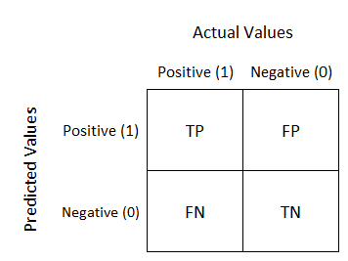
DATA SPLITTING
Evaluation Techniques
The dataset is split in the ratio of 80:20, i.e. 80% for training all four models and 20% of the dataset for testing those models.
For testing the results of the models, we used K-Fold validation technique to test the best model, followed by gaining all metric value for test. These metric values include:
Confusion Matrix
Precision
Recall
F1 Score

Slide 21
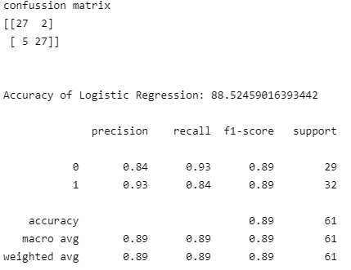
Training and testing the models
Logistic Regression
Model Test Result

Slide 22
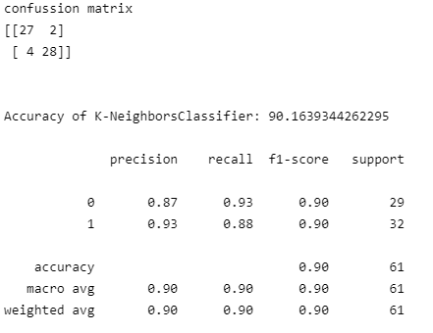
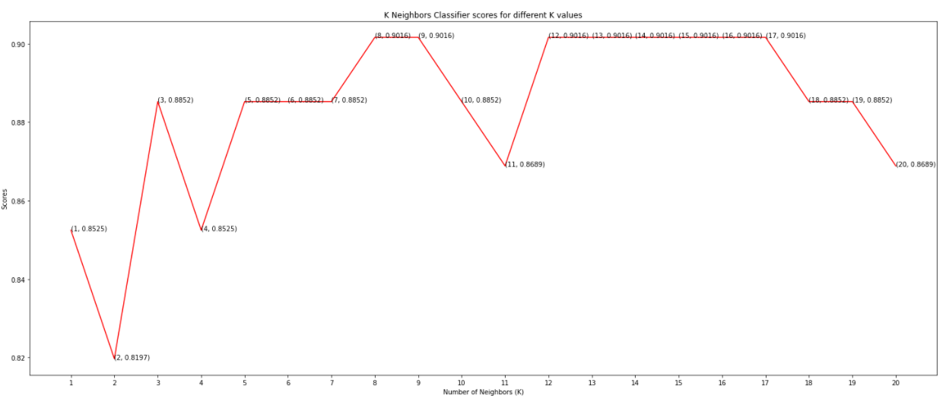
2. K Nearest Neighbor
Finding Optimal Value of K
Model Test Result

Slide 23
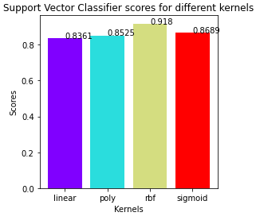
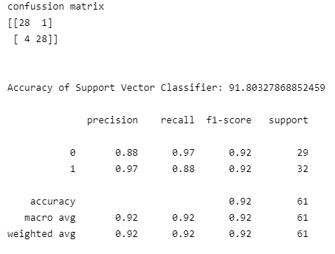
3. Support Vector Machine
Finding Best Kernel
Model Test Result

Slide 24
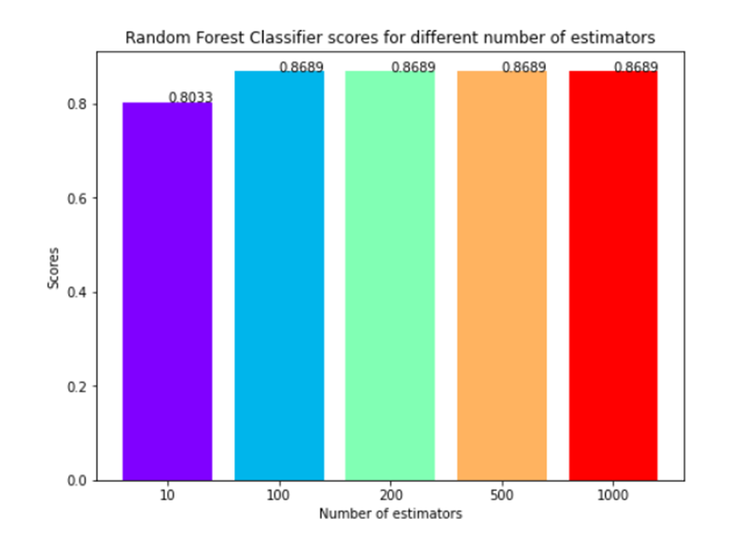
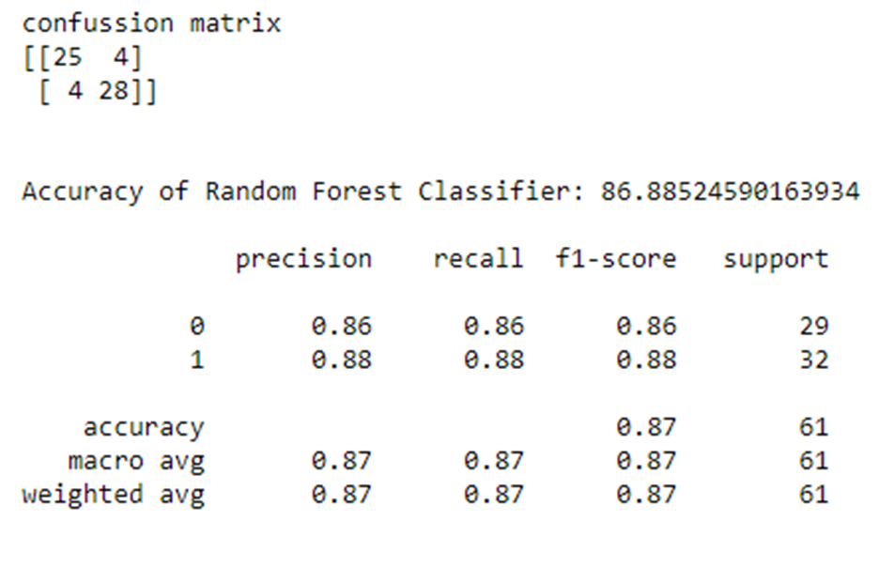
4. Random Forest Classifier
Finding Optimal Value of Estimators
Model Test Result

Slide 25
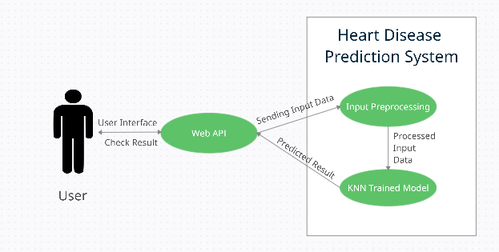
Flow of Project
The user uses the Web API to access the heart disease prediction system and provides input in form of attributes. These attributes are preprocessed and result is predicted after processing the input through the trained model.

Slide 26
Conclusion
The project included the necessary data preprocessing and examination of the client data for heart disease.
Four models were trained and tested with maximum scores (accuracy), below follows a comparison of our results with the base papers.
From the above table we can conclude that the K-NN model gives us the highest accuracy of 91.80%.
Models\Results (%) | [1] | [2] | The proposed method
Logistic Regression | 87.5 | 86.51 | 88.52
KNN | 88.52 | N/A | 91.80
SVM | N/A | 79.77 | 90.16
Random Forest | 85.1 | 80.89 | 86.88

Slide 27
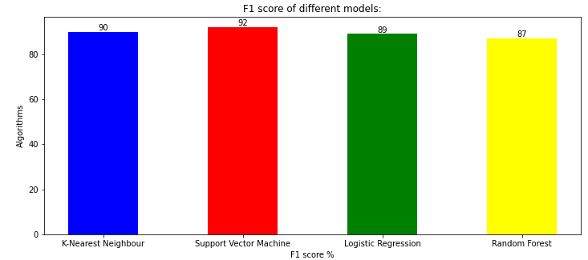
The key factors from the dataset leading to heart diseases from the dataset are:
Exercise Induced Angina
Chest Pain
ST Depression when workout compared to the amount of Rest taken
Maximum heart rate achieved
Major vessels coloured by fluoroscopy
Below follows a comparison of F1 score for the all 4 models:

Slide 28
References
Jindal H, Agrawal S, Khera R, Jain R & Nagrath P (2020). Heart disease prediction using machine learning algorithms. 1st International Conference on Computational Research and Data Analytics (ICCRDA 2020).
Kumar G Dinesh; K Arumugaraj; Kumar D Santhosh; V Mareeswari (2018). Prediction of Cardiovascular Disease Using Machine Learning Algorithms. 2018 International Conference on Current Trends towards Converging Technologies (ICCTCT).
Mohan K S; Thirumalai C; Srivastava G (2019). Effective Heart Disease Prediction Using Hybrid Machine Learning Techniques. IEEE Access ( Volume: 7).
Ghosh P; Azam S; Jonkman J M; Karim A; Samrat F. M. J M; Ignatius E (2021).Efficient Prediction of Cardiovascular Disease Using Machine Learning Algorithms with Relief and LASSO Feature Selection Techniques. IEEE Access ( Volume: 9).
Joshi R; Peng Z;Long X; Feijs L; Andriessen P (2019). Predictive Monitoring of Critical Cardiorespiratory Alarms in Neonates Under Intensive Care.IEEE Journal of Translational Engineering in Health and Medicine ( Volume: 7).
Chen J; Valehi A; Razi A (2019). Smart Heart Monitoring: Early Prediction of Heart Problems Through Predictive Analysis of ECG Signals. IEEE Access ( Volume: 7).

Slide 29
Thank You

